Slide 1

Lab 7: Agentic AI in Physics Analysis Pipeline

Slide 2
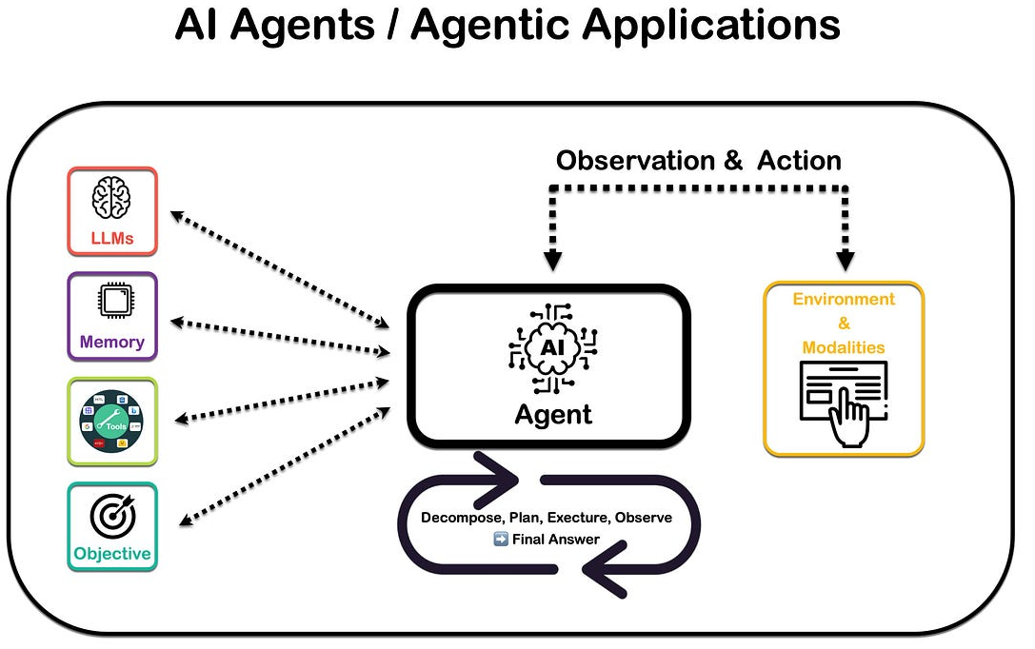
What is Agentic AI?
An agent is program or artificial intelligence that observes its environment and then interacts with said environment
Can be rules based, algorithm based, or even use a Large Language Model!
https://boomi.com/

Slide 3
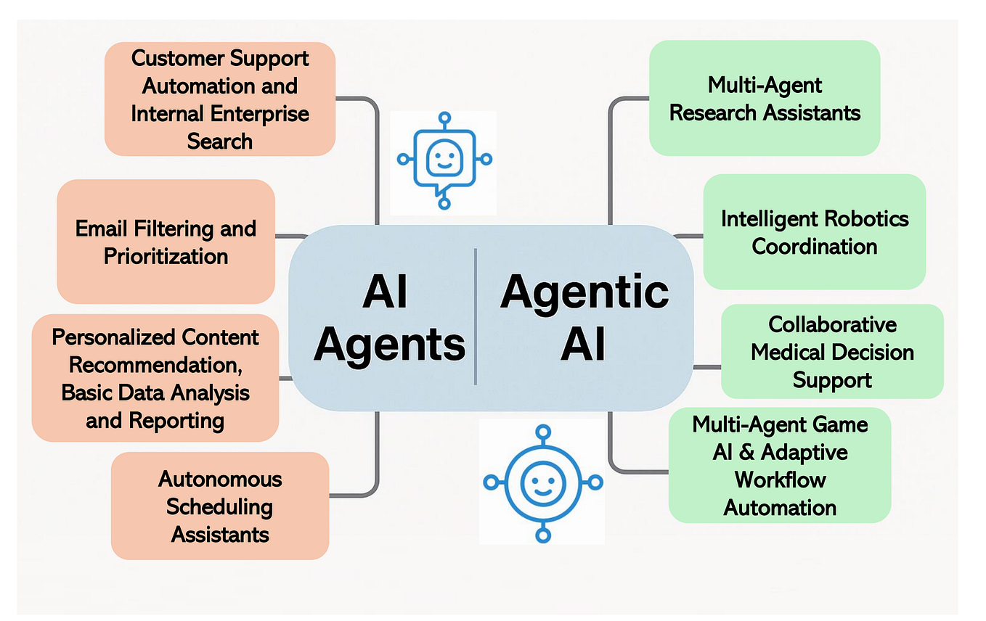
What is Agentic AI Used For?
Agents can be used used to filter emails or help automate finding research papers
Even automate certain physics analysis!
www.medium.com

Slide 4
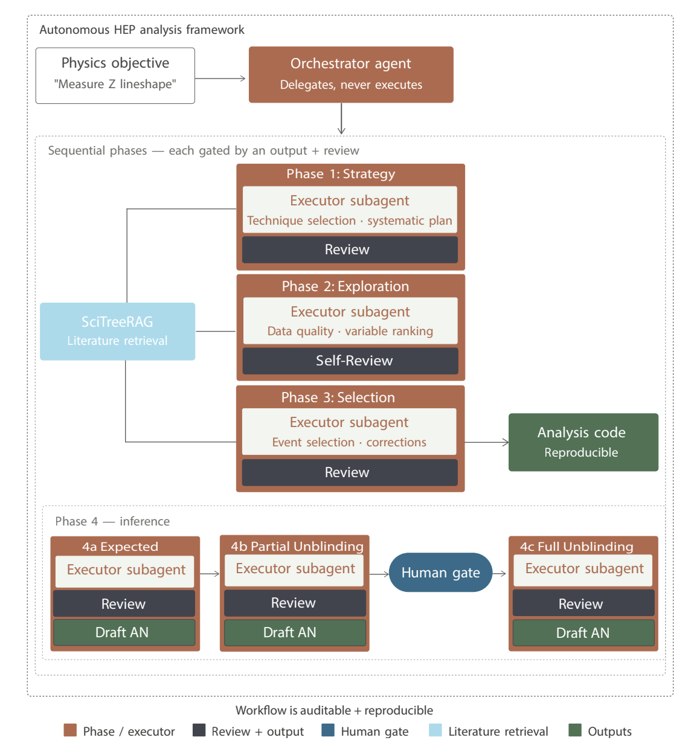
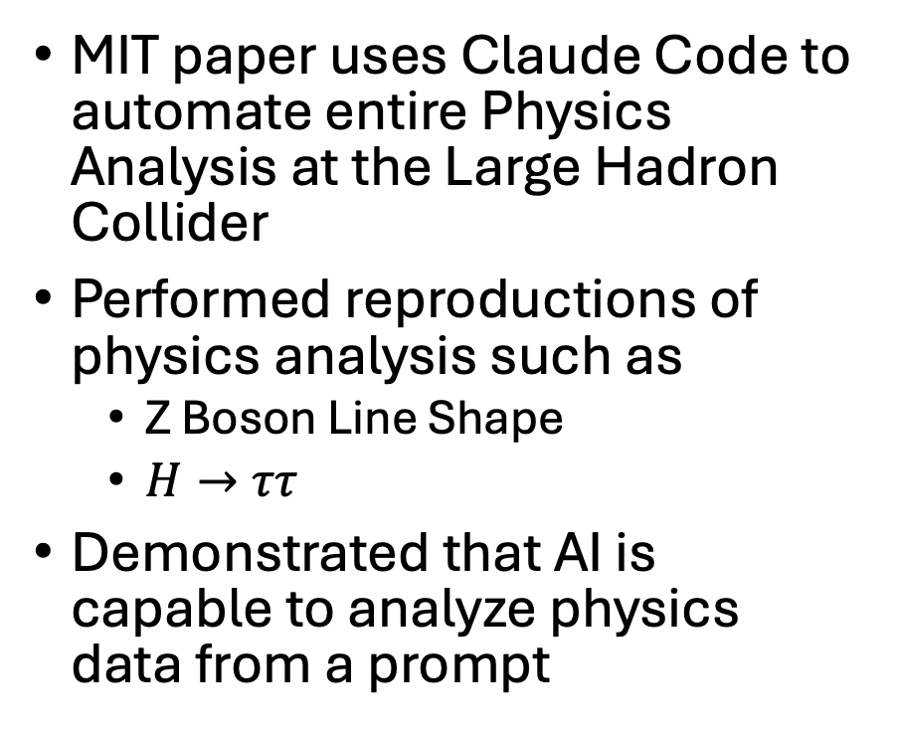
Emerging Agentic Workflows in Physics
MIT paper uses Claude Code to automate entire Physics Analysis at the Large Hadron Collider
Performed reproductions of physics analysis such as
Z Boson Line Shape
$H→ττ$
Demonstrated that AI is capable to analyze physics data from a prompt
https://arxiv.org/pdf/2603.20179

Slide 5
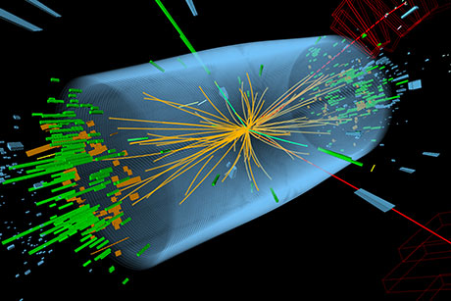
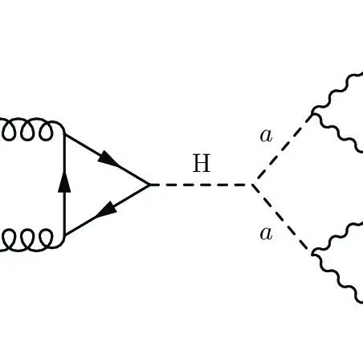
Lab 7 – Exotic Higgs Decay Agentic Analysis
Use agents to automate physics discovery in collider data
Exotic Higgs could decay to 4 b quarks which form Jets in the collider
Since quarks by themselves are highly unstable due to confinement more quarks appear to stabilize the state
Heavy QCD background jets from other processes

Slide 6
Lab Agentic Workflow
Feature Agent
Raw Data
Goal: Setup Agentic pipeline to automate classification model testing and hyper parameter tuning
Test at least 4 different classification models to the baseline random forest model
Get at least a significance of 45 using any classification model
Classification Agent
Signal Agent
Human
Planning Agent

Slide 7
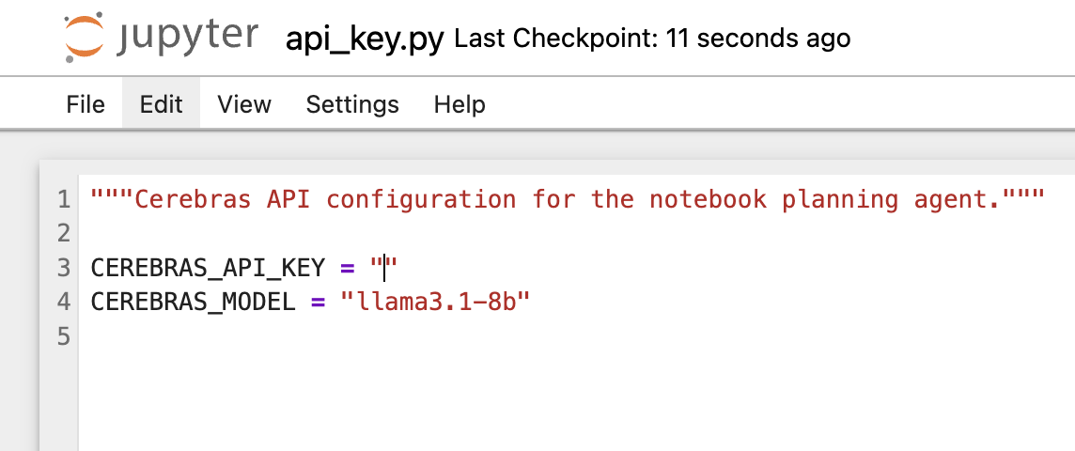
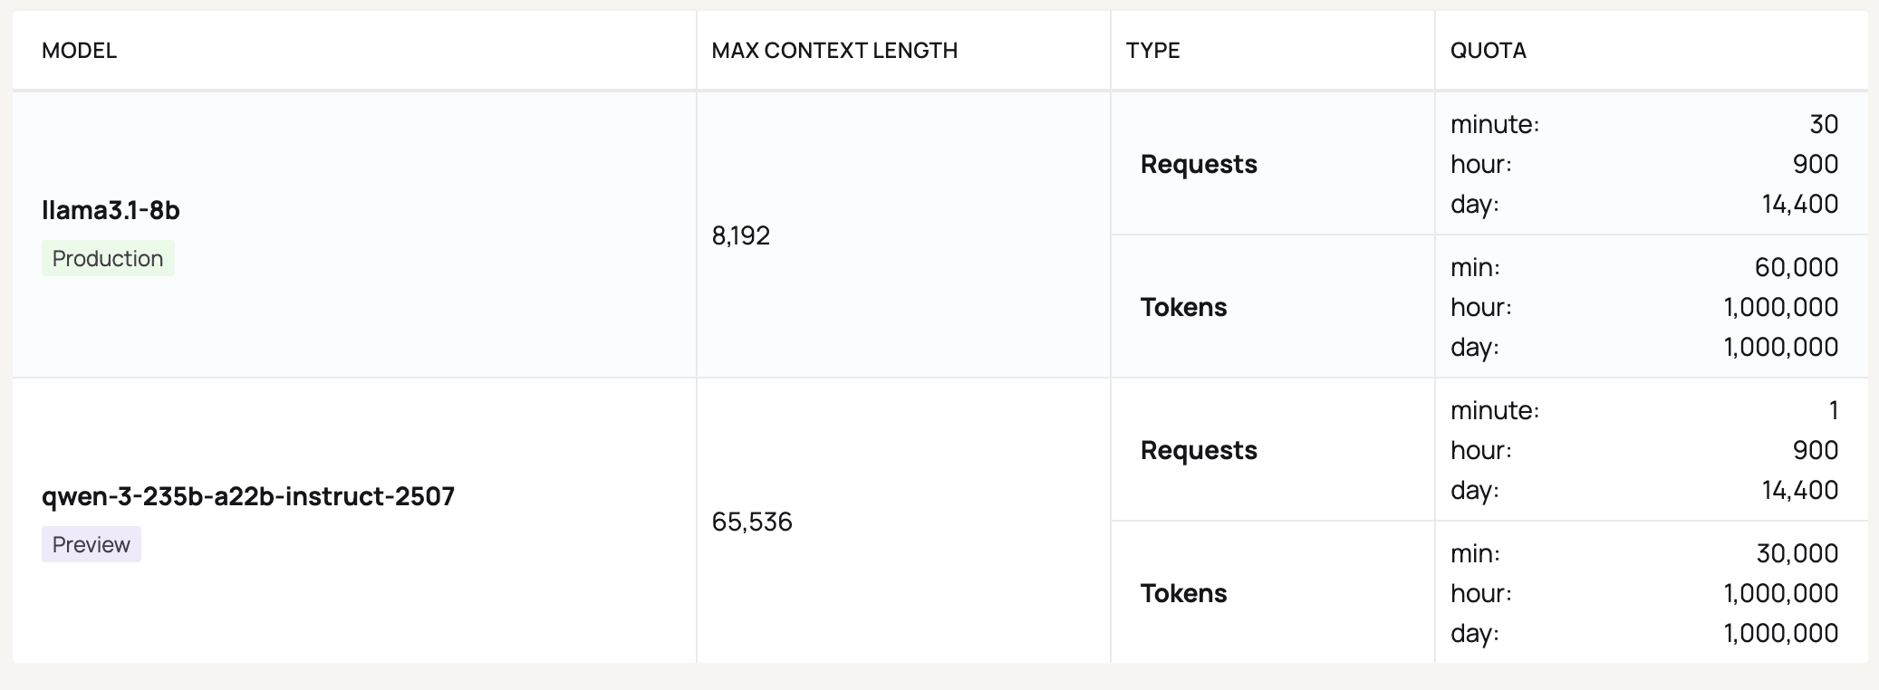
Setting up Cerebras for Free Tokens
https://cloud.cerebras.ai/
Free account with uw email
Free API key
Use llama3.1-8b in general
All free models open weight!

Slide 8
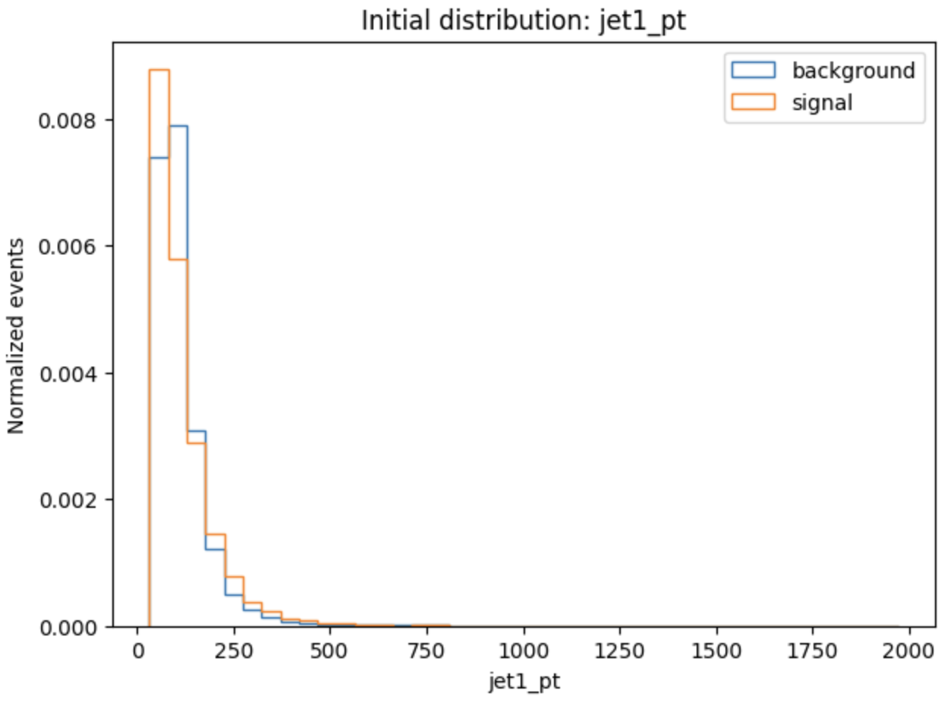
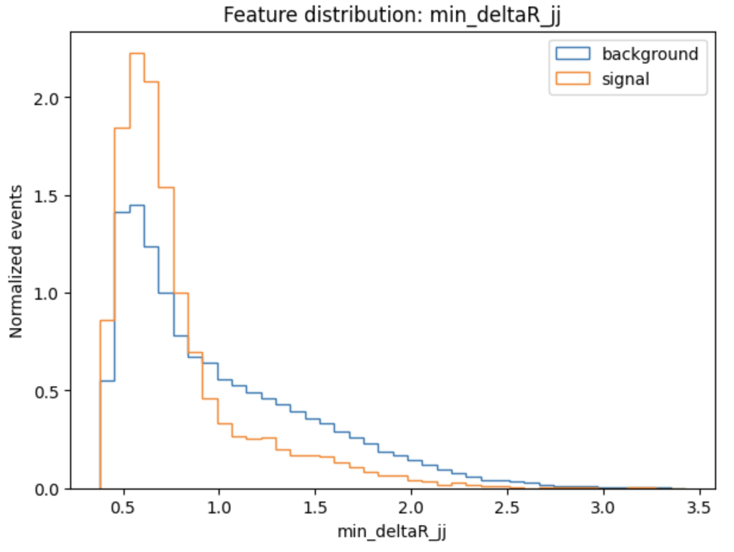
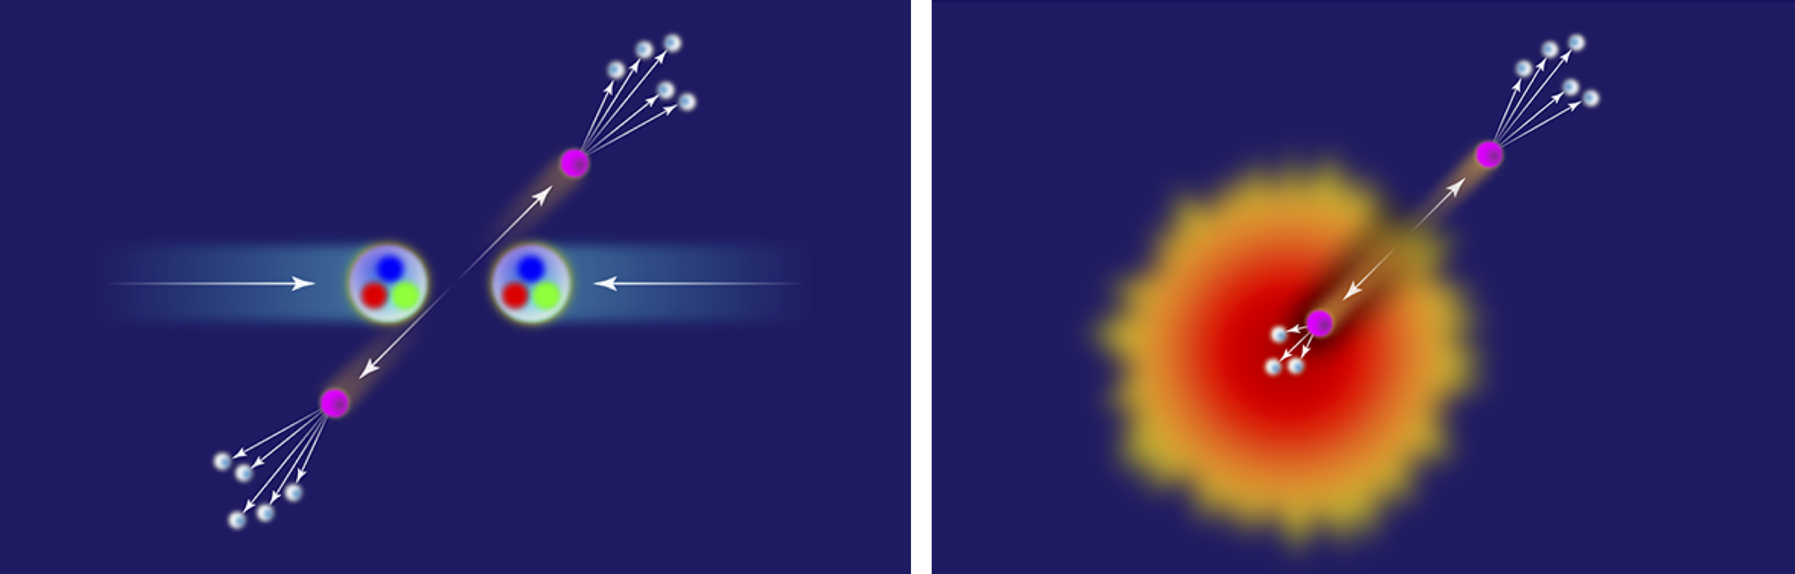
Feature Extraction Agent
Need to transform raw data to features used in classification model
Angular separations between jets, invariant masses etc…
https://www.jamesdmulligan.com/project/jet_measurements/

Slide 9
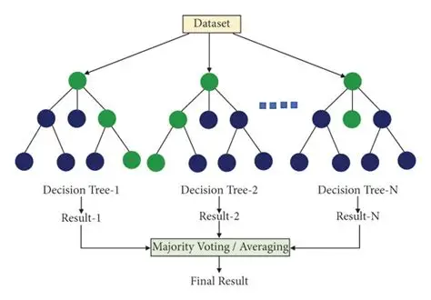
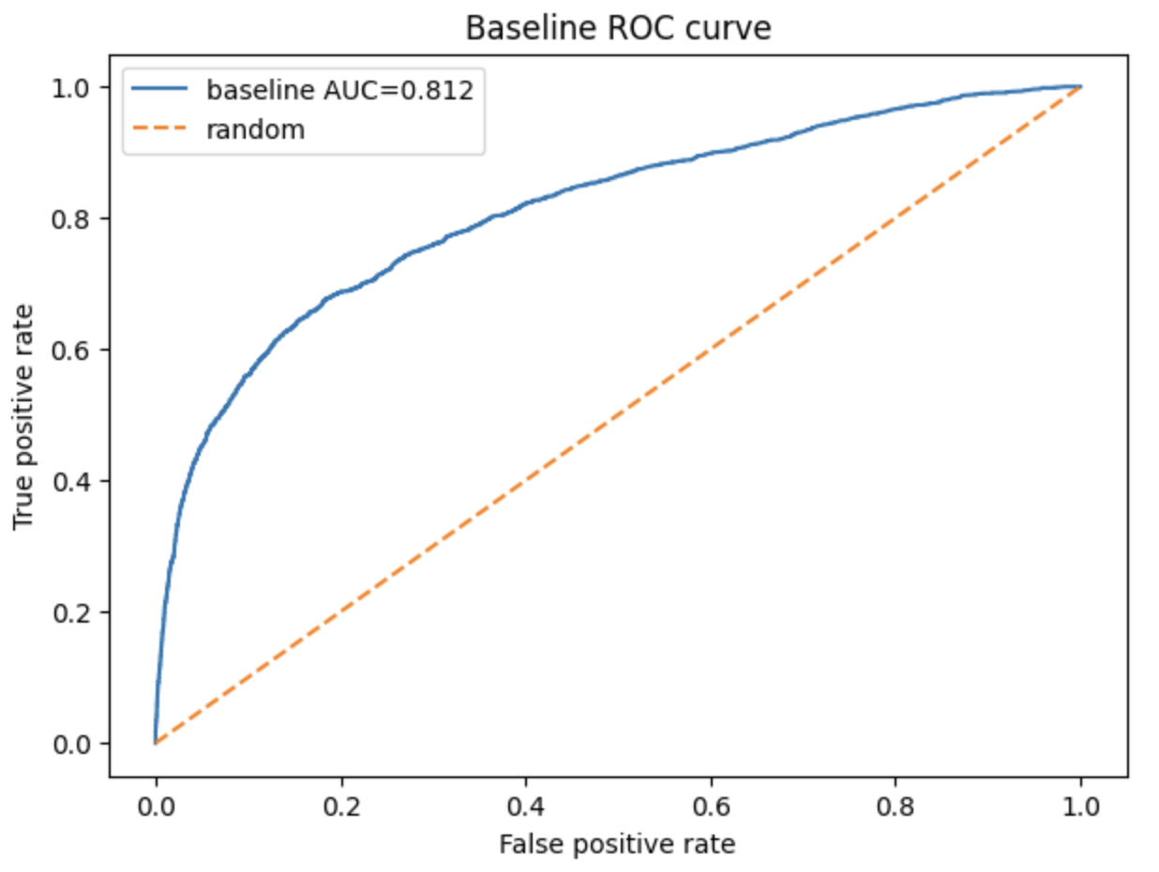
Classification Agent
Baseline is random forest
Can fill out additional classification models for the Planning Agent to test out
Plot Receiving Operator Characteristic Curve (ROC)
Area Under Curve (AUC) is the area under the ROC curve

Slide 10

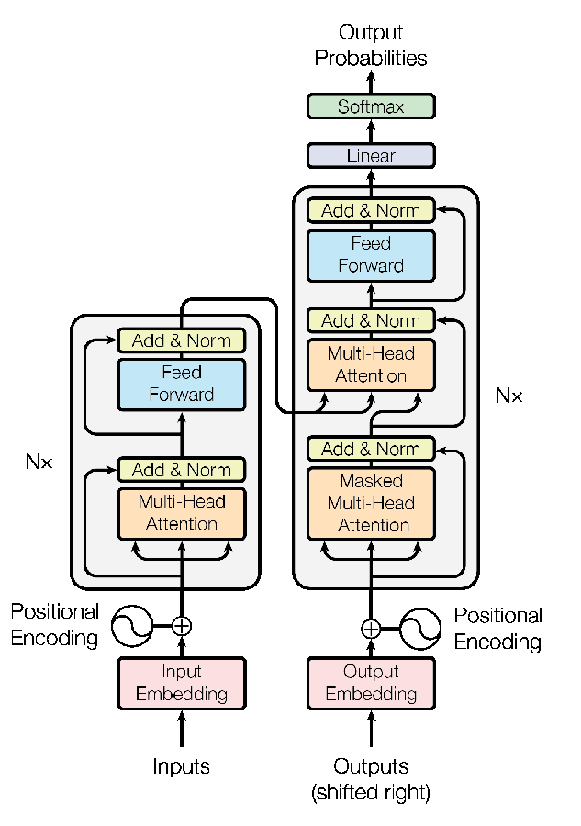
Planning Agent
Llama3.1-8B is still not a great coding model
Planning Agent reviews results from last run
Tune hyper parameters, features selection, or even try a new model
Add many different types of classification model to the planning agent has ample opportunities to test

Slide 11
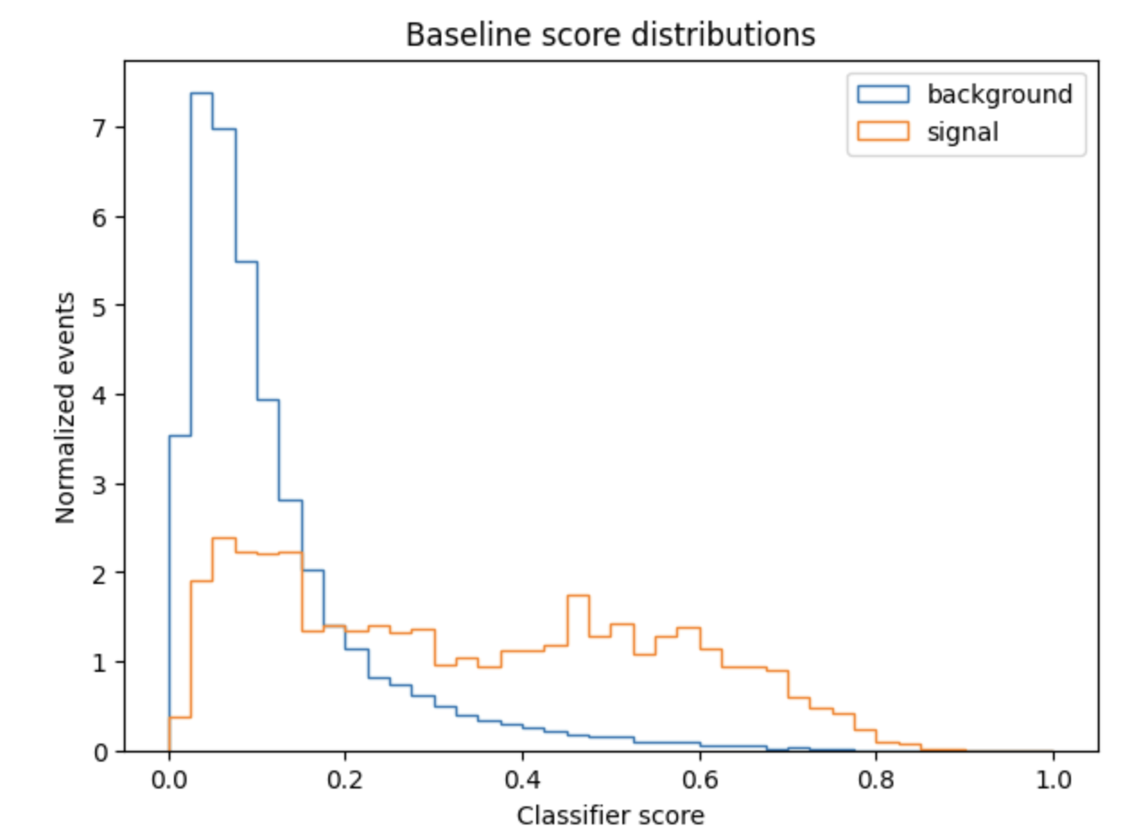
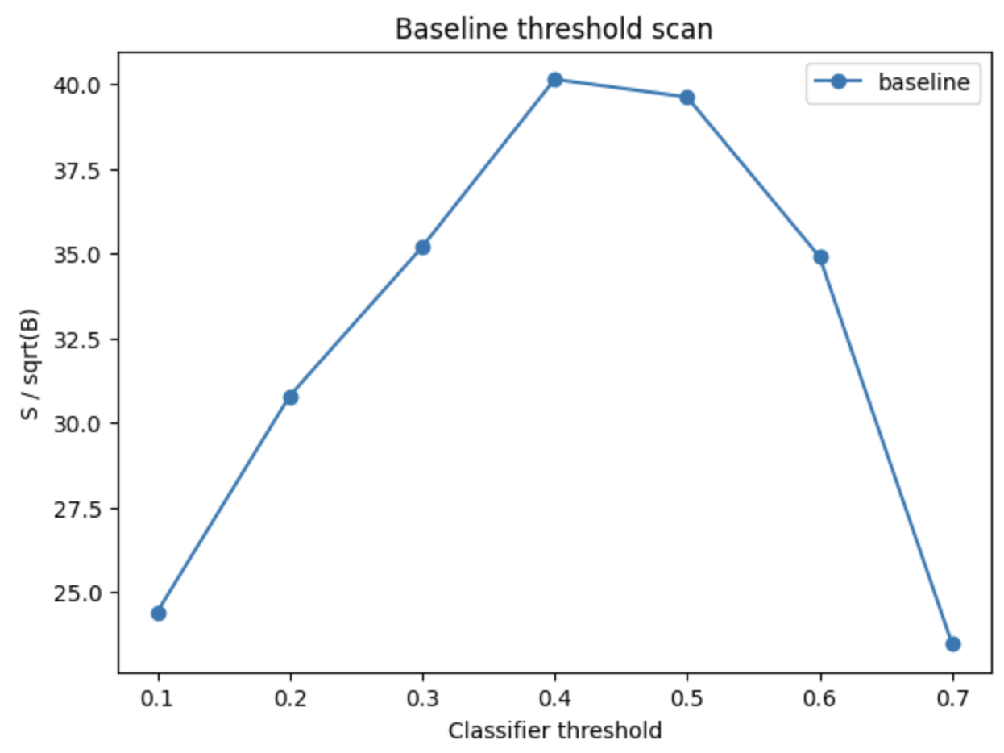

Signal Analysis Agent
Scan signal to background threshold from the used classifier
Significance – Of the events that pass the threshold how many are signal or background?
Significance > 5 is discovery
What other figures of merit for the analysis?

Slide 12
Putting it Together
Feature Agent
Raw Data
After completing each agent put together the loop
Try at least 5 different classification models
Goal is to beat random forest baseline and try 4 different models
Classification Agent
Signal Agent
Human
Planning Agent

Slide 13
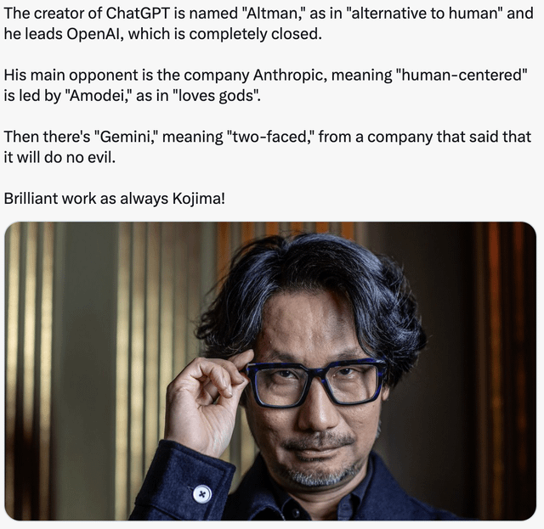
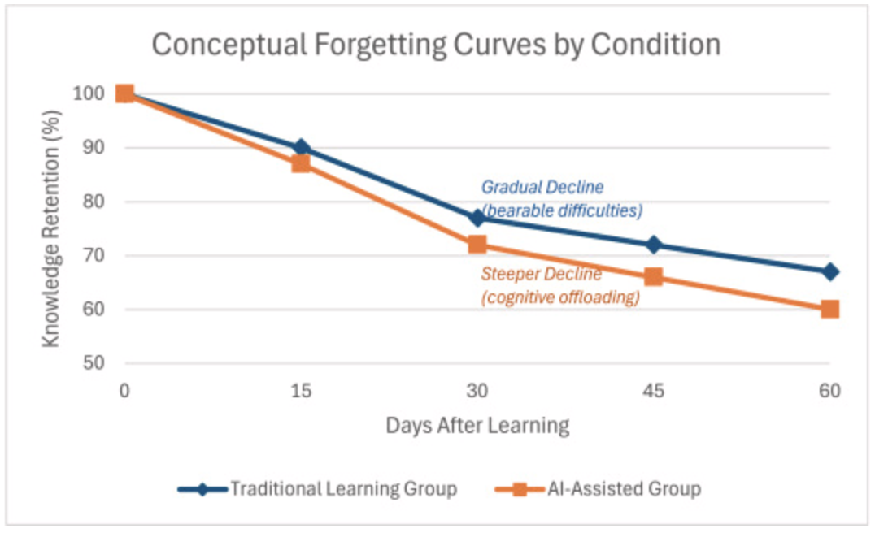
Outlook
AI is a tool meant to help us learn and do more / higher quality work.
AI is not meant to replace humans!
It is irrational to fear new technology, but rational to be concerned about how it is used.
Using AI too much can hurt learning retention. Be cautious in how you use it!
https://www.sciencedirect.com/science/article/pii/S2590291125010186

